Slide 1

Artathon
Lineage mutations team
Using ordered mutations to cluster clones.
June 23rd, 2021

Slide 2
Details
We will use the lp15 dataset.
We are focusing on subject D207.

Slide 3
Outline
Each clone has a lineage of mutations that stem from the germline sequence.
We will build a “word document” for each clone using its mutations.
Once we have a document for every clone, we will use the Doc2Vec machine learning algorithm to find similarities between documents (clones in our case).
The output of Doc2Vec will be an embedding for every clone.
We will use the embeddings to cluster clones.
Finally, we will attempt to elucidate the similarities that clones share in each cluster.

Slide 4
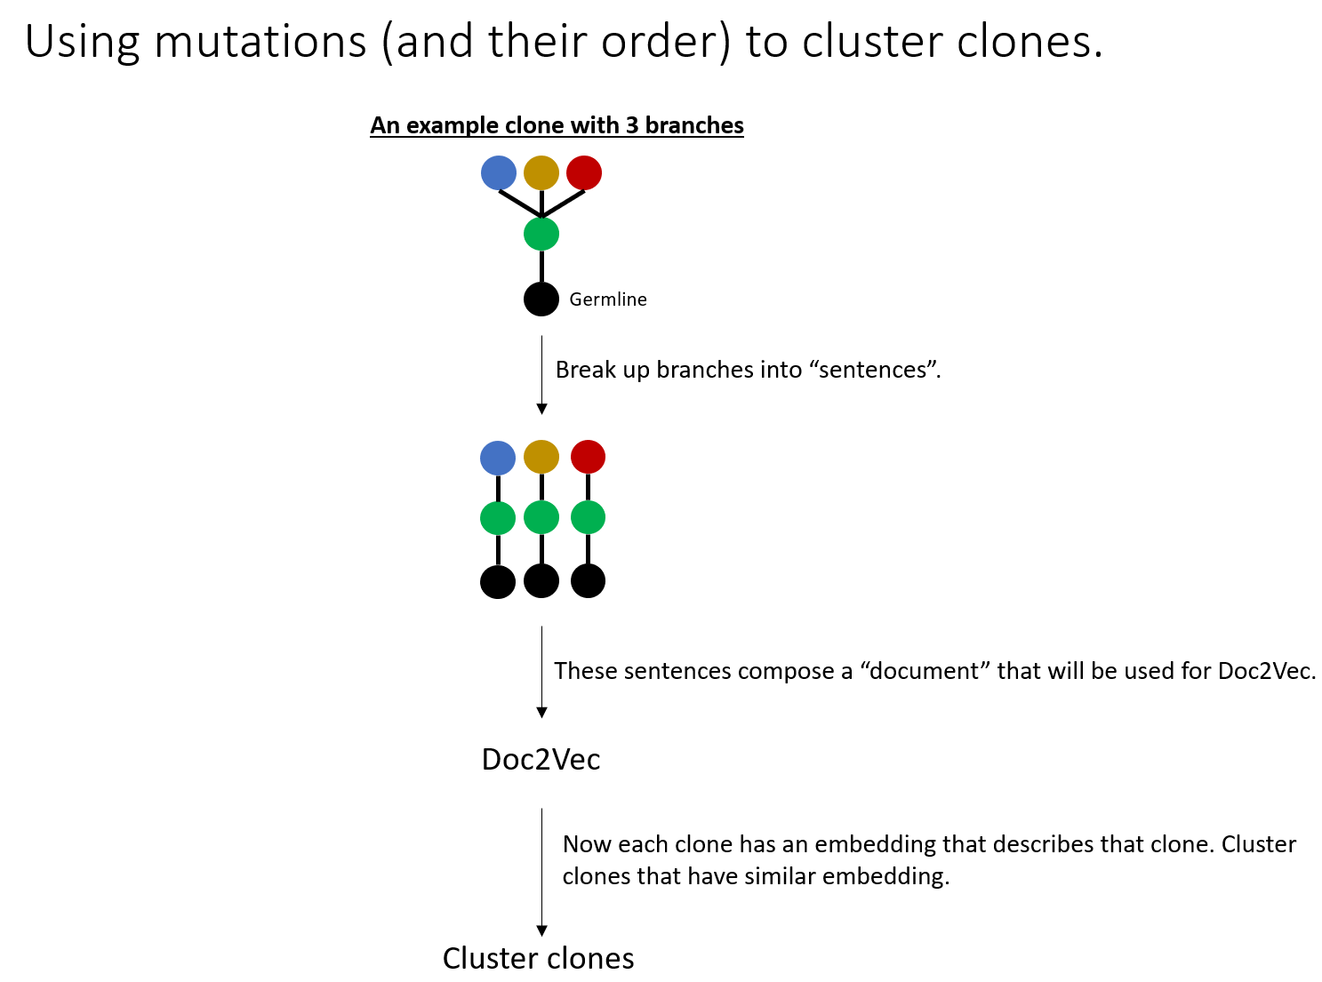

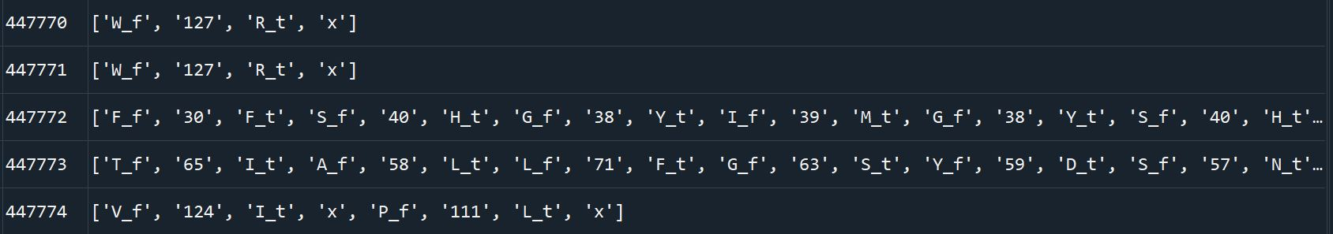
Example Data
Each clone is represented by a list of mutations and their positions.
_f is added to the pre-mutated amino acid. E.g. “from”
_t is added to the mutated amino acid. E.g. “to”
For example: W 127 R becomes W_f, 127, R_t
Each branch of mutations ends with an “x” and is followed by the next branch (if there is one).
Branch #1
Branch #2
Explore/validate clusters

Slide 5
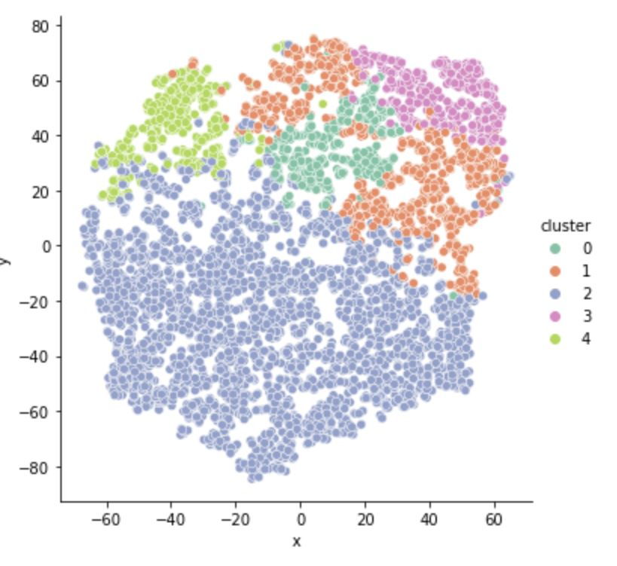
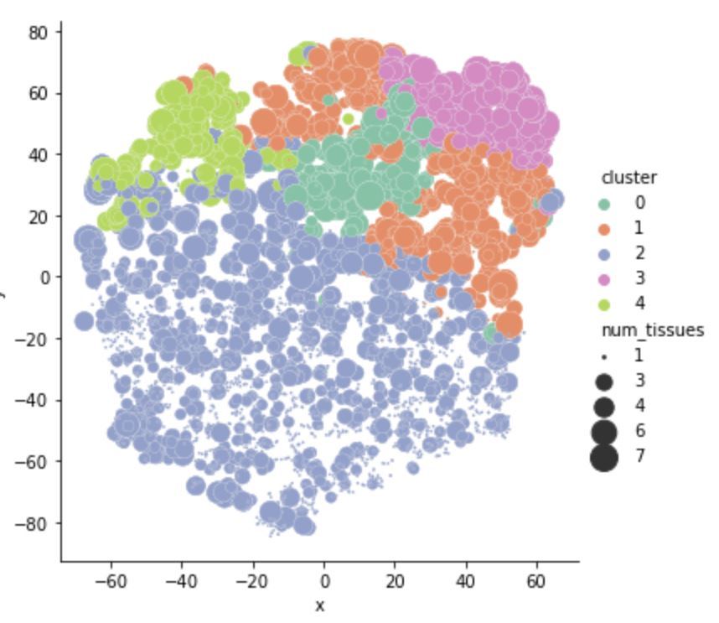
Result of Doc2Vec
Colored by clusters
Colored by clusters and clone size (tissue span)

Slide 6
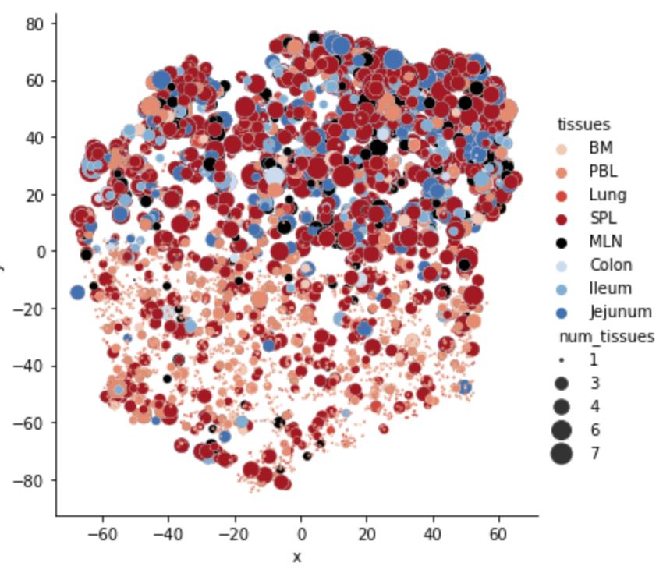
Result of Doc2Vec
Colored by clusters and clone size (tissue span)
Colored by tissue and clone size (tissue span)

Slide 7
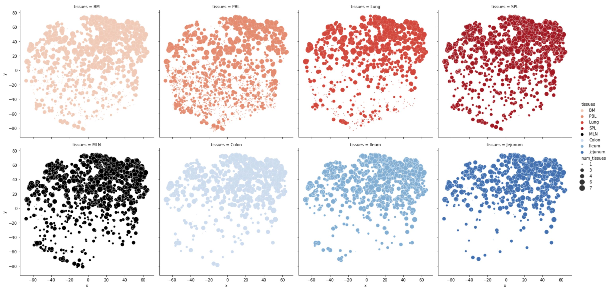
Result of Doc2Vec
Clones separated by tissue

Slide 8
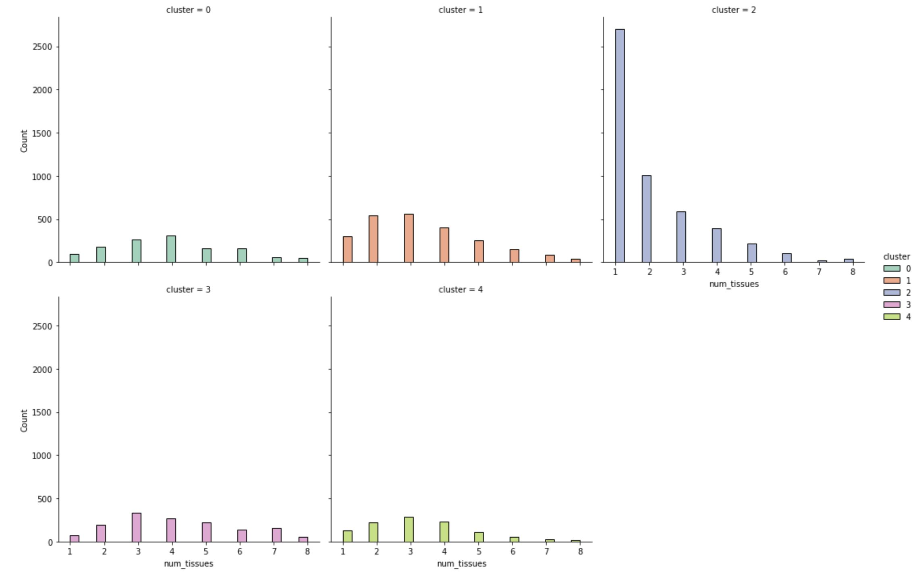
Number of clones per tissue span.

Slide 9
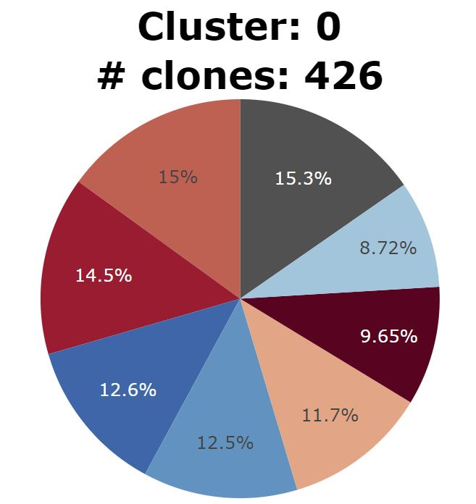
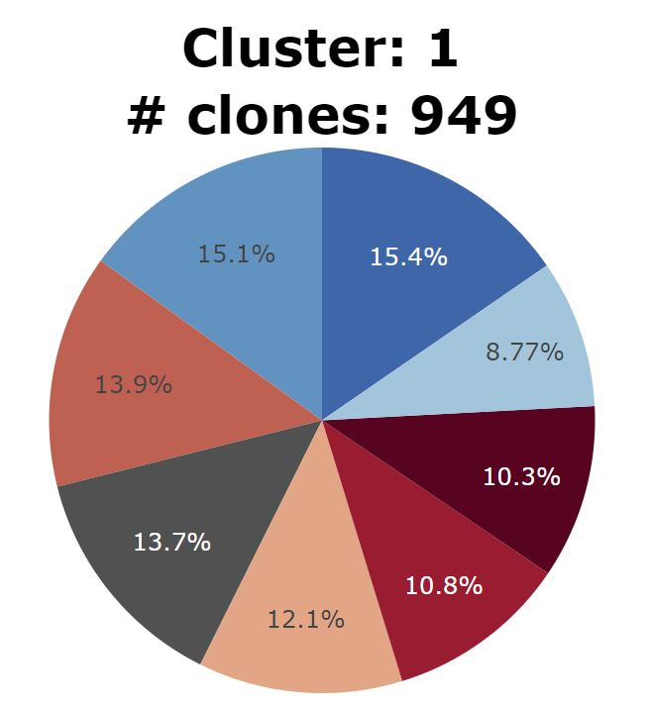
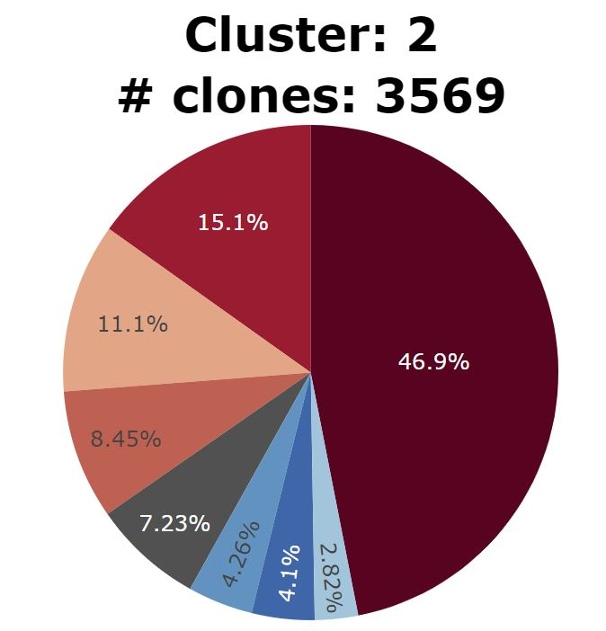
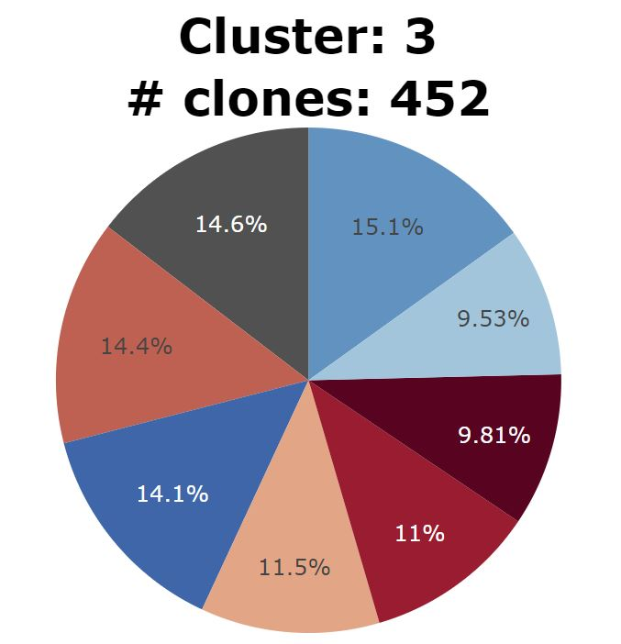
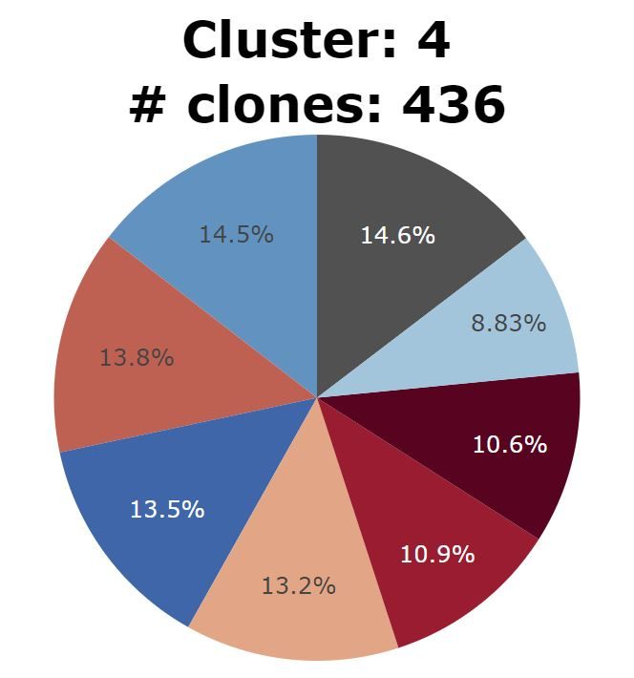
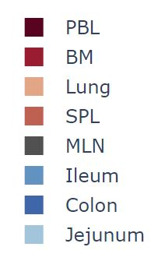
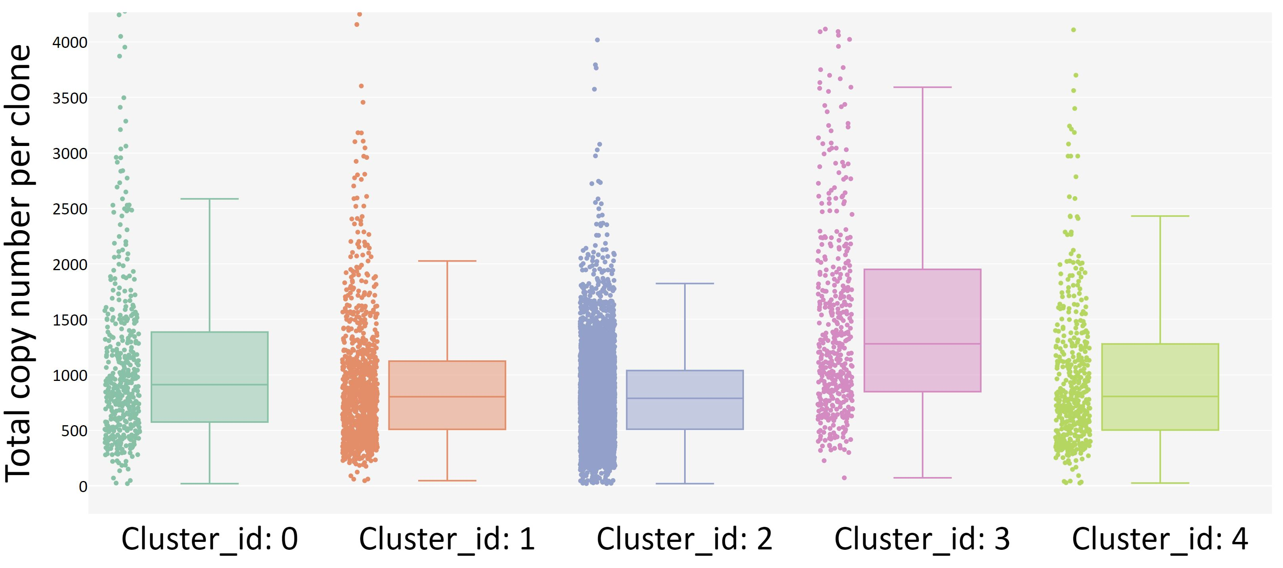
Copy number per clone.

Slide 10
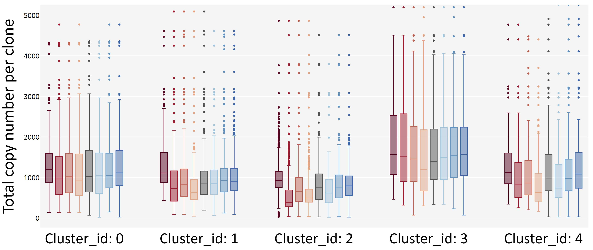
Copy number per clone by tissue.

Slide 11
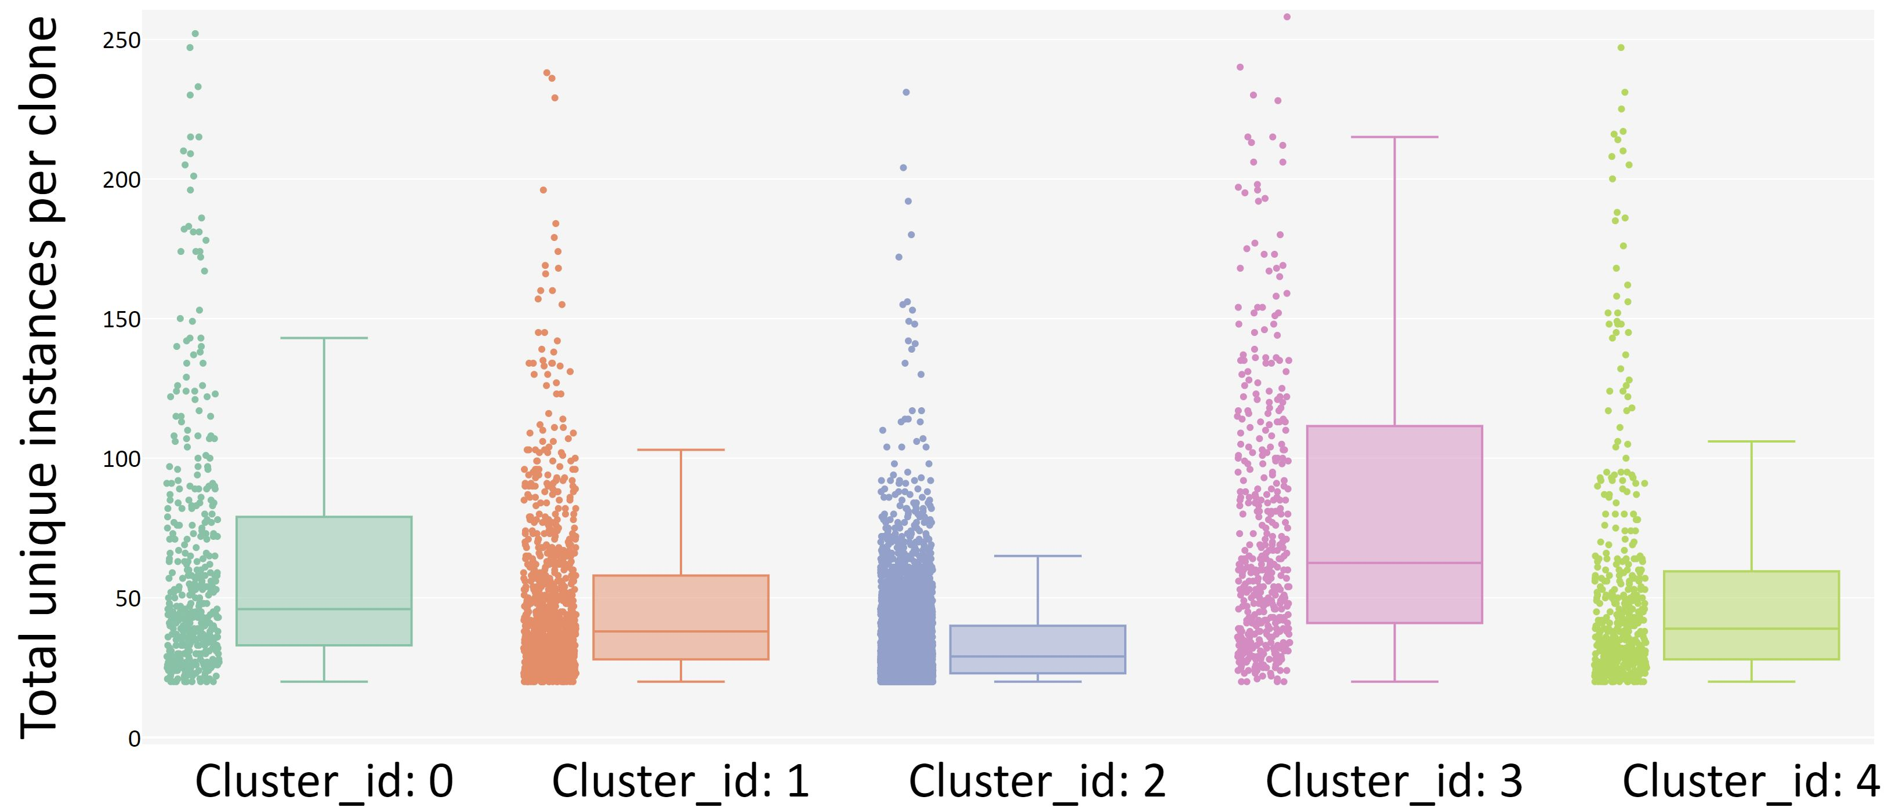
Unique instances per clone.

Slide 12
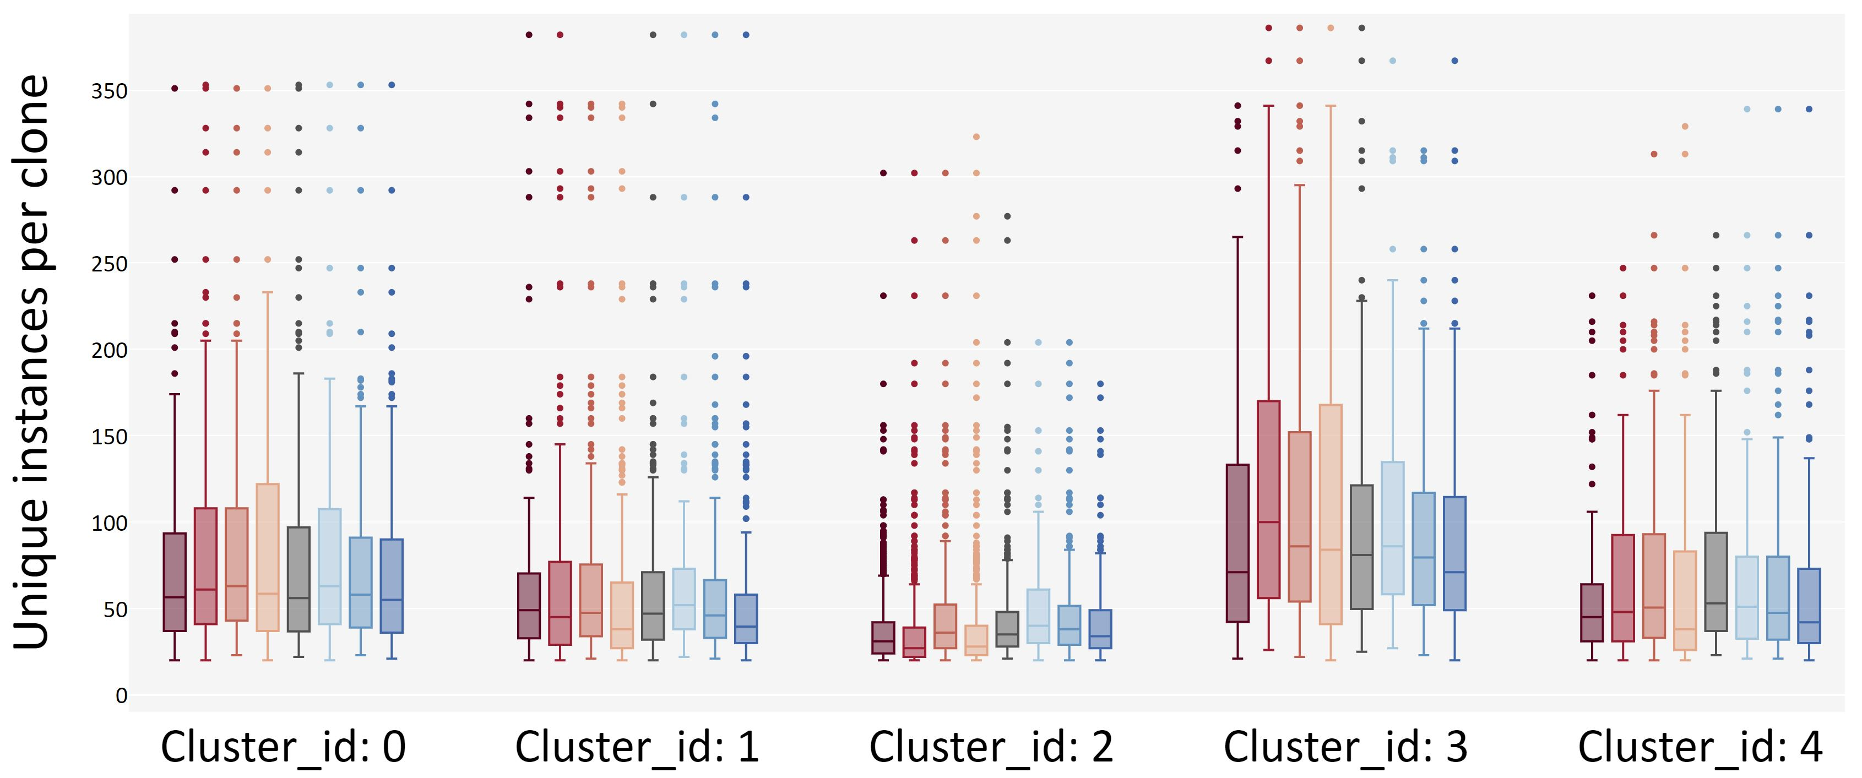
Unique instances per clone by tissue.

Slide 13
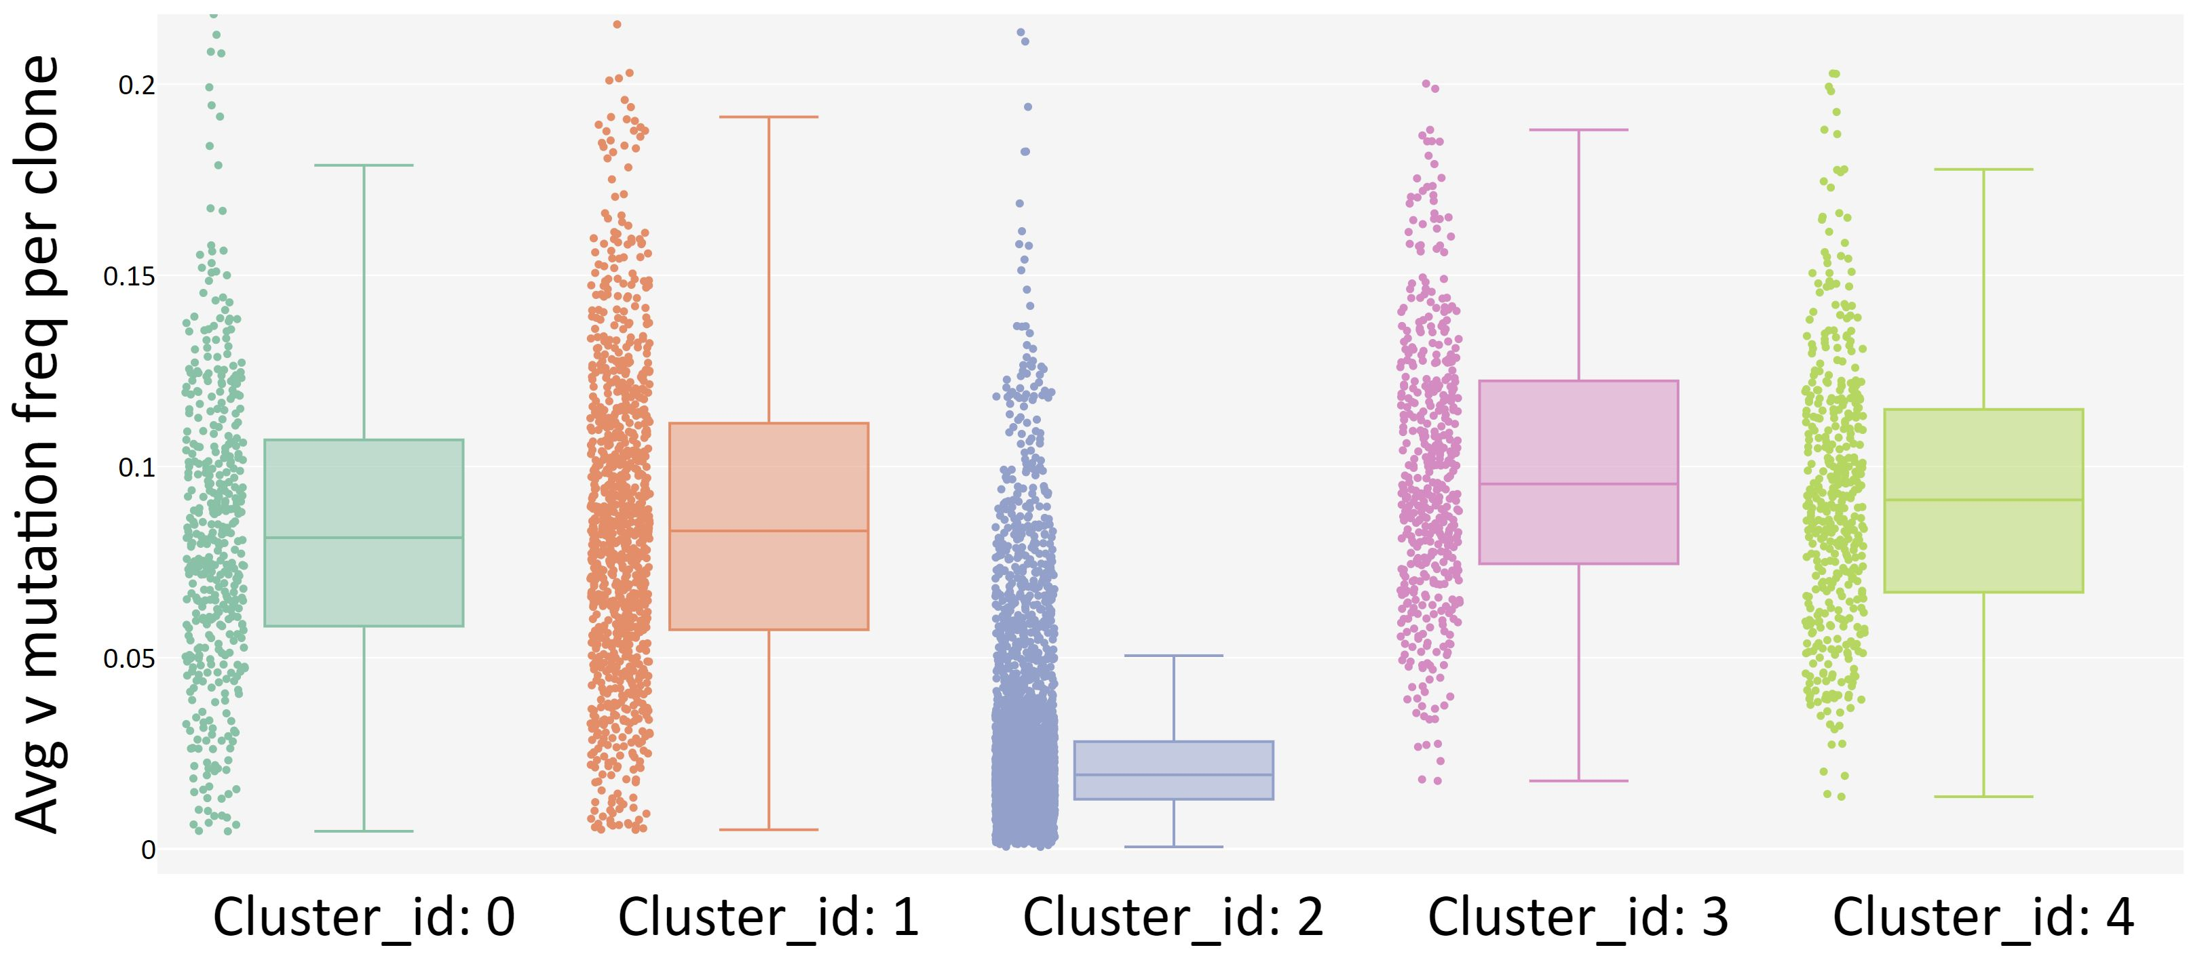
Average v gene mutation frequency per clone.

Slide 14
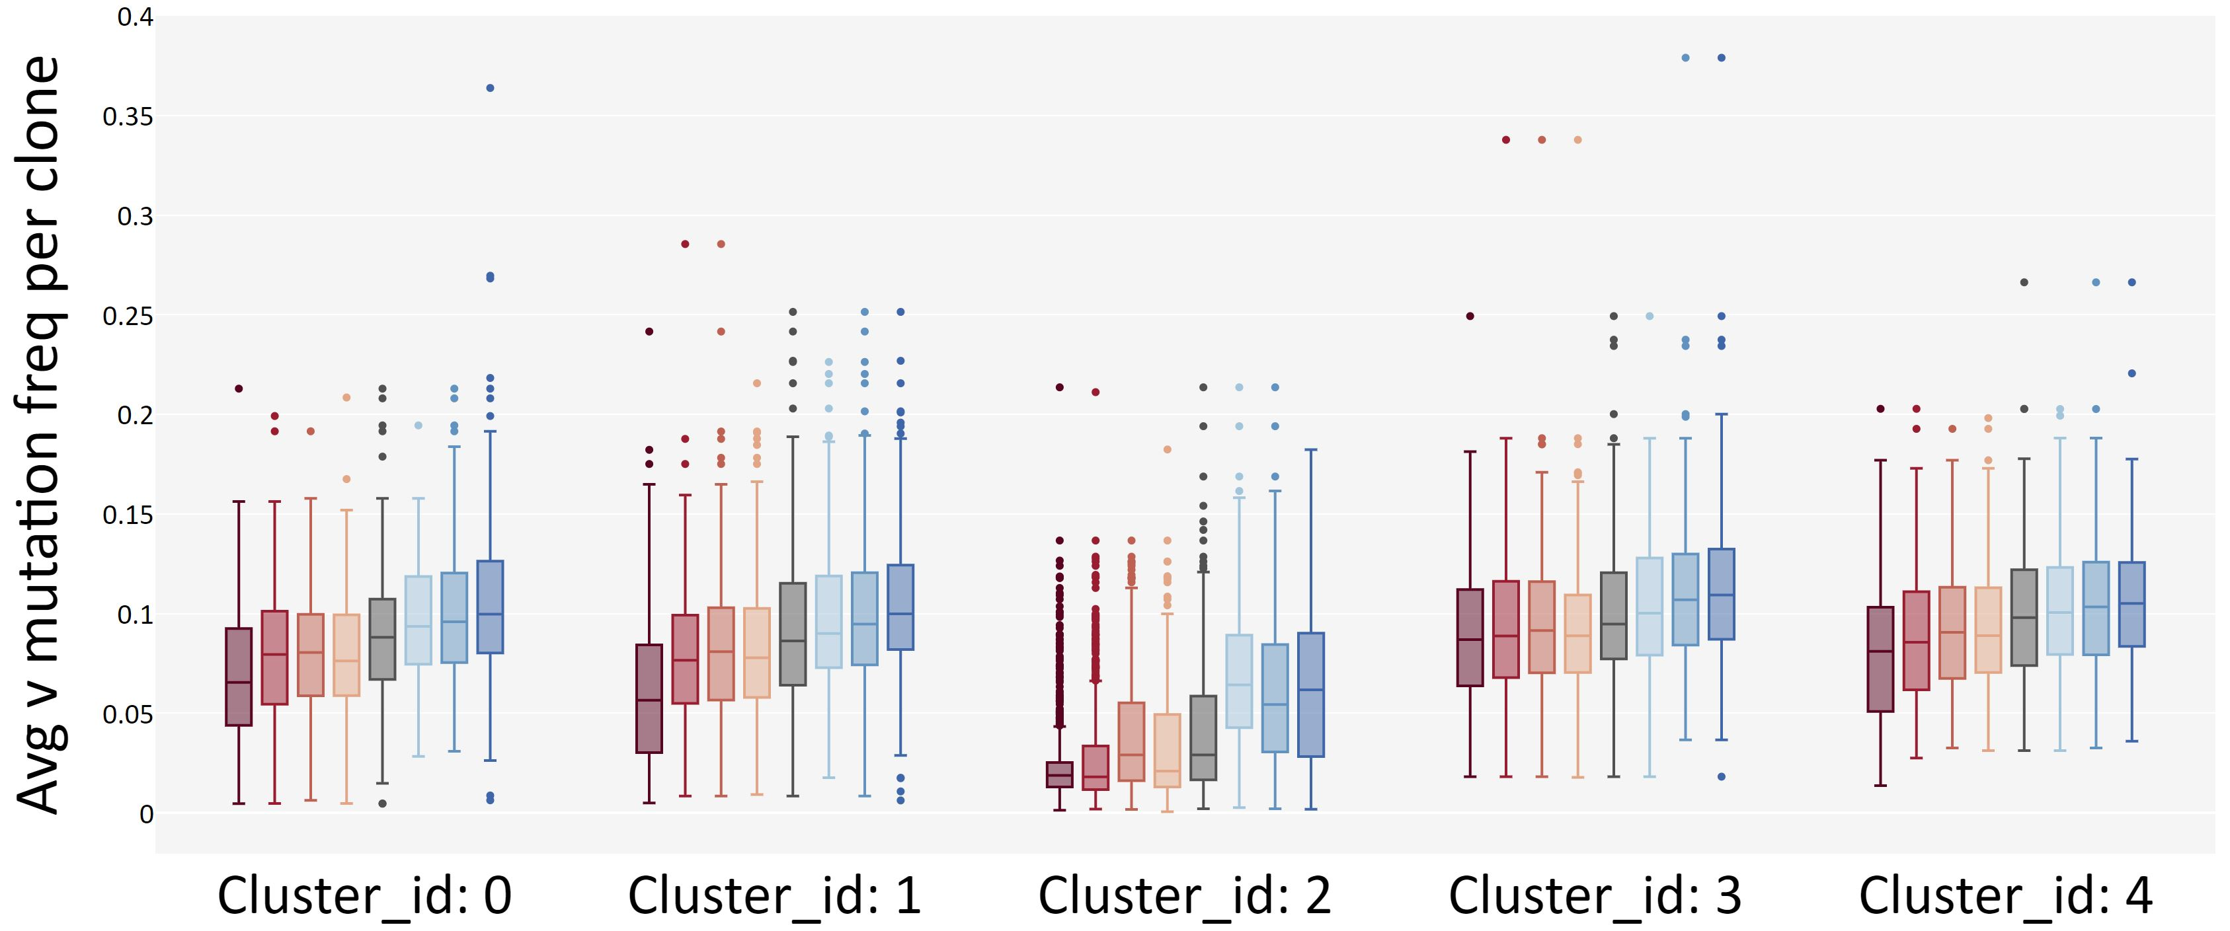
Average v gene mutation frequency per clone by tissue.

Slide 15
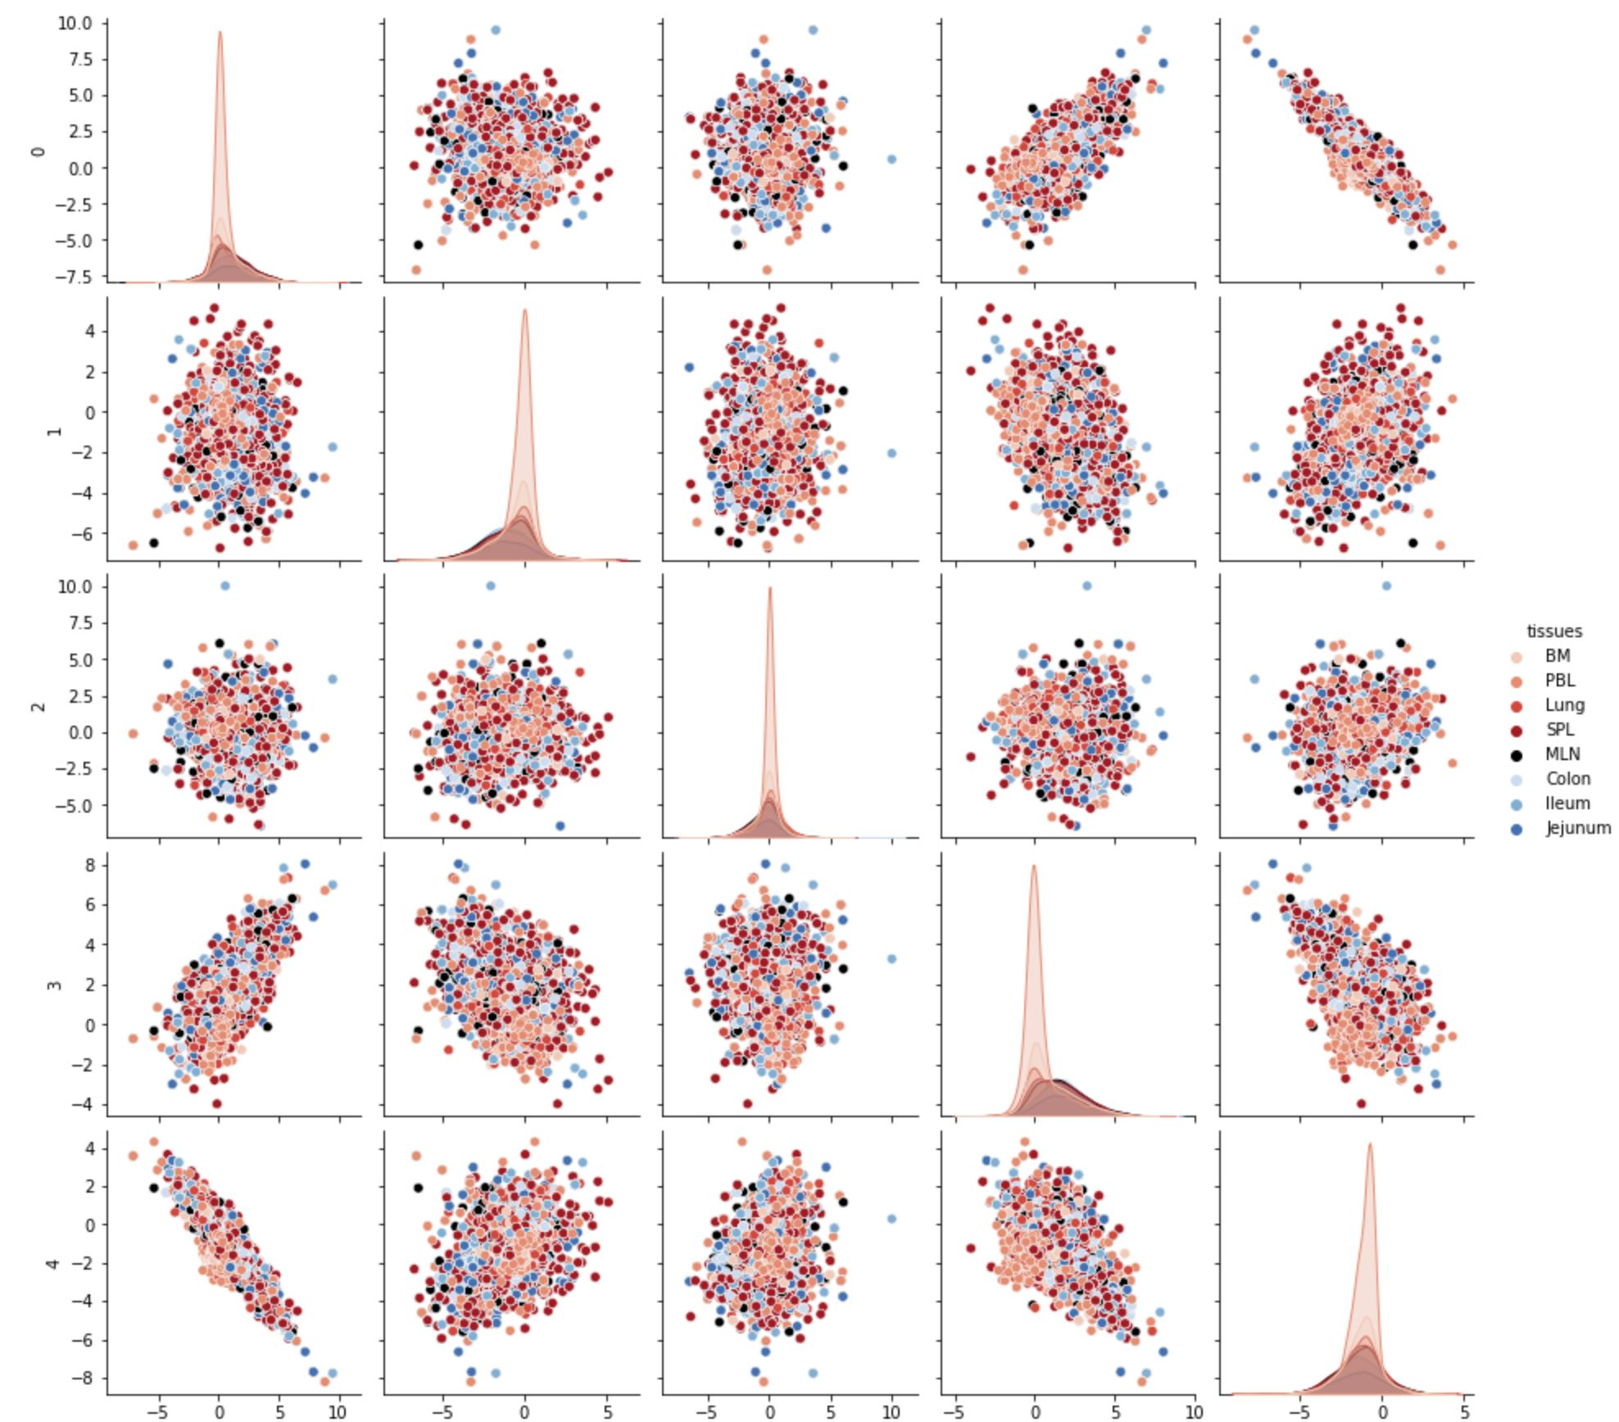
Embedding correlation between clusters
0 = first embedding
1 = second embedding
etc…

Slide 16
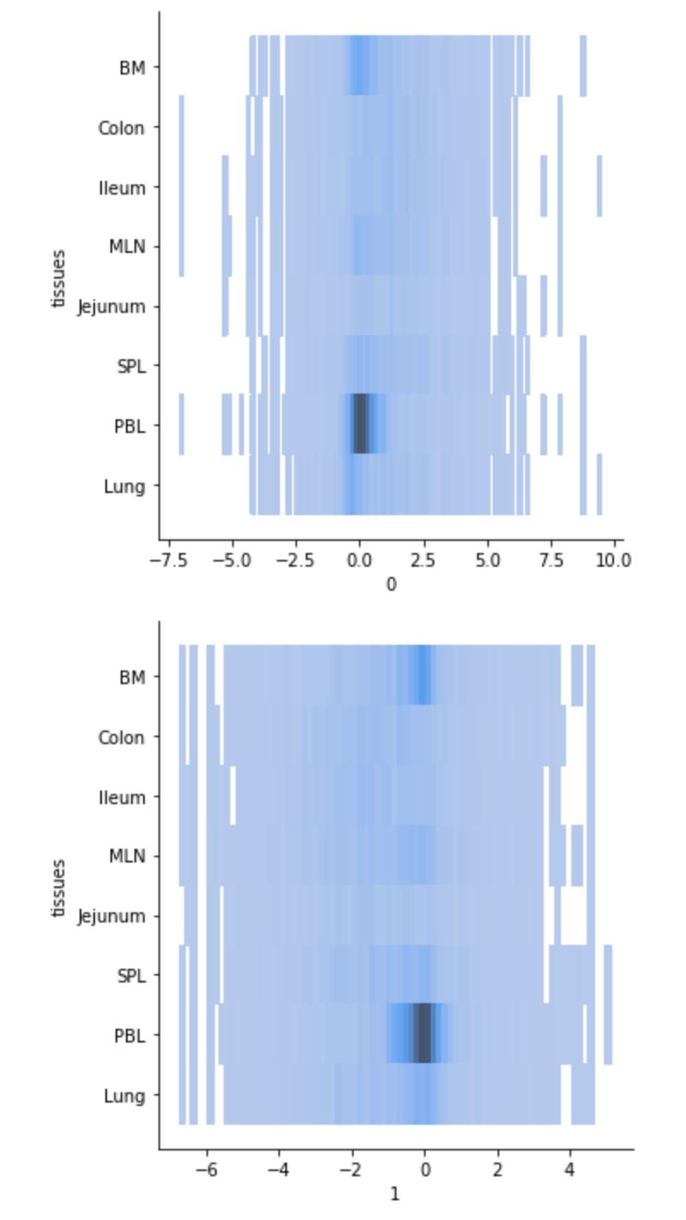
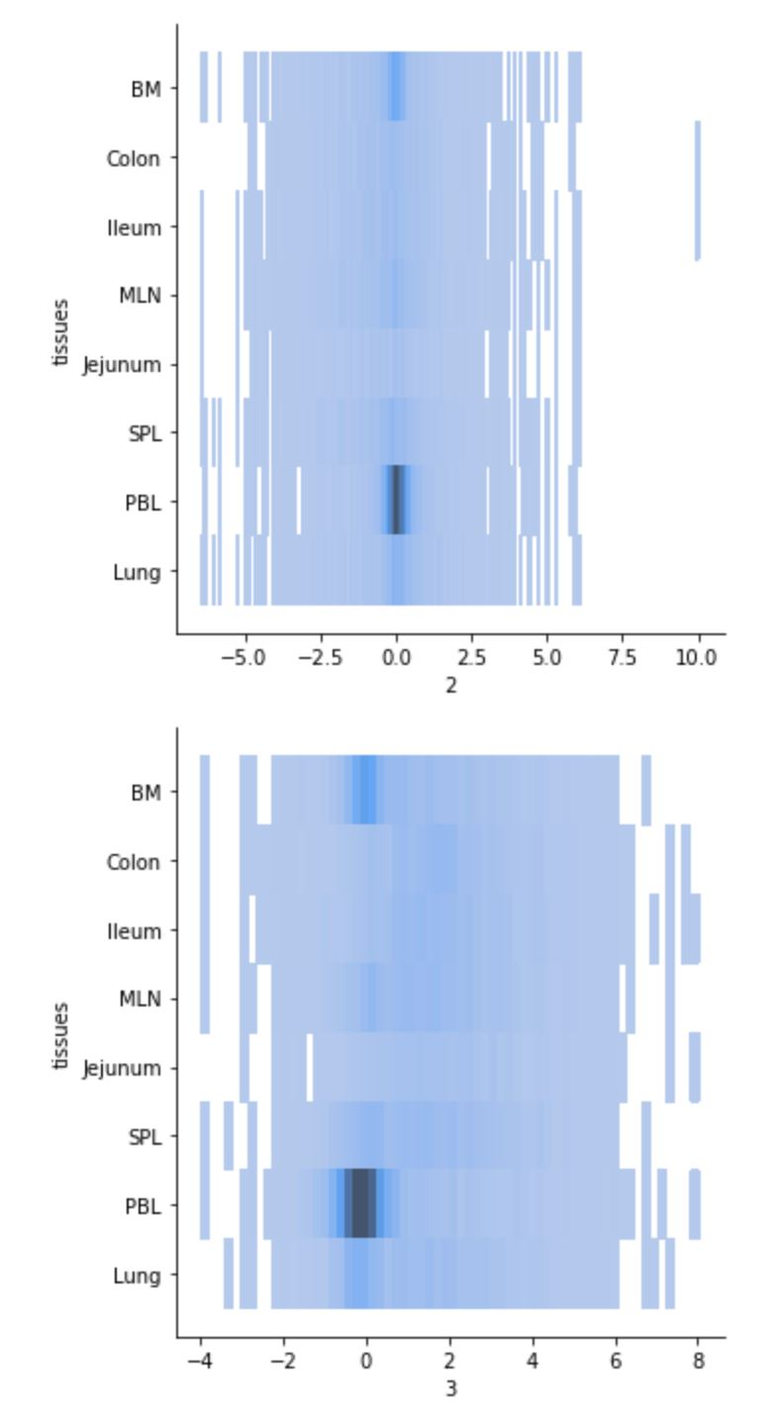
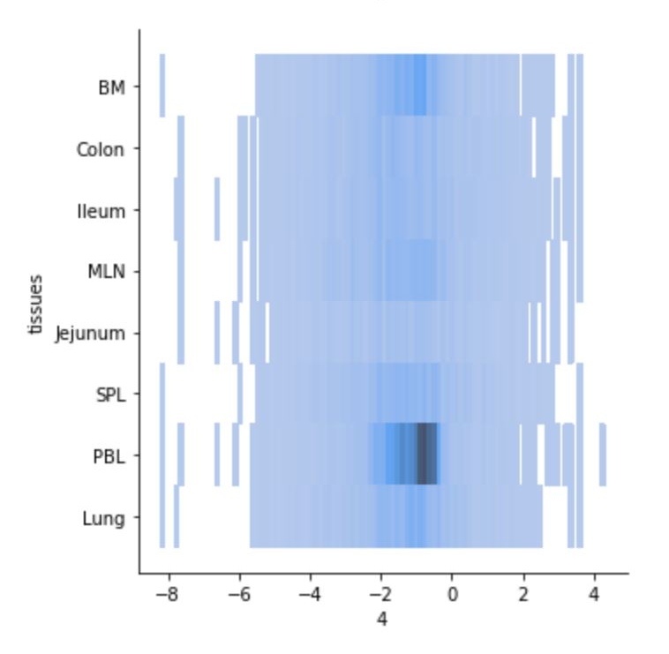
Embedding distribution among tissues.
0 = first embedding
1 = second embedding
etc…

Slide 17
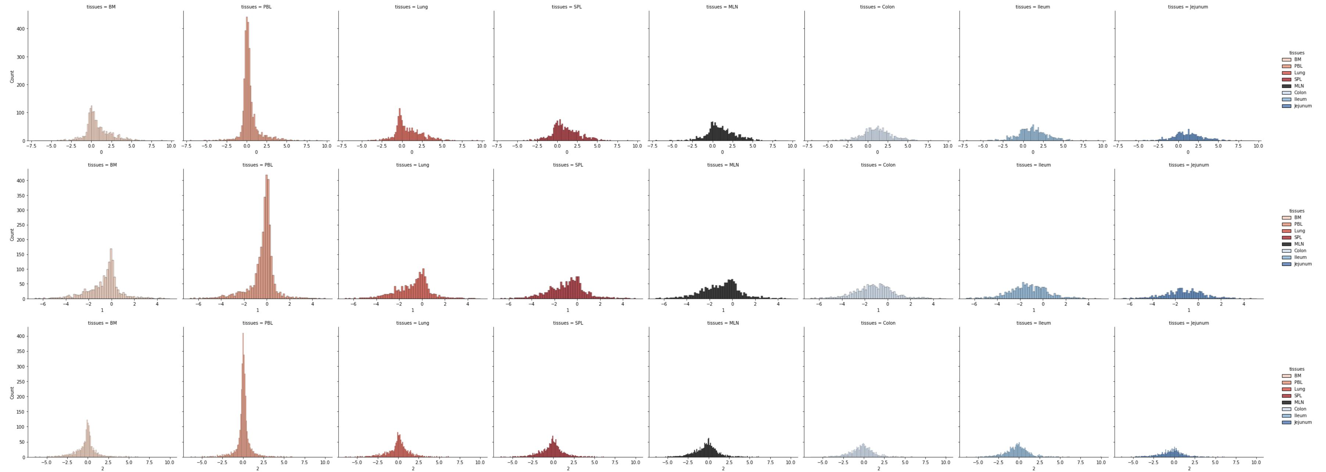
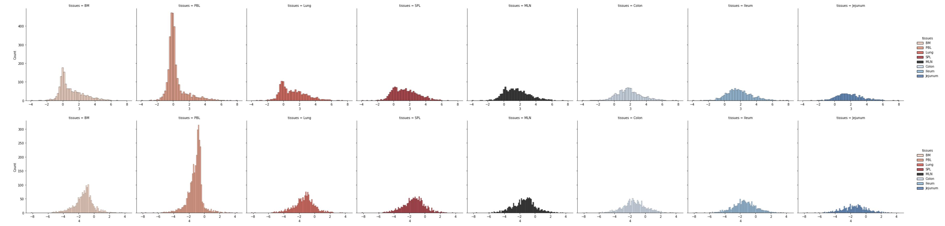
Embedding distribution by tissue and cluster
0 = first embedding
1 = second embedding
etc…

Slide 18
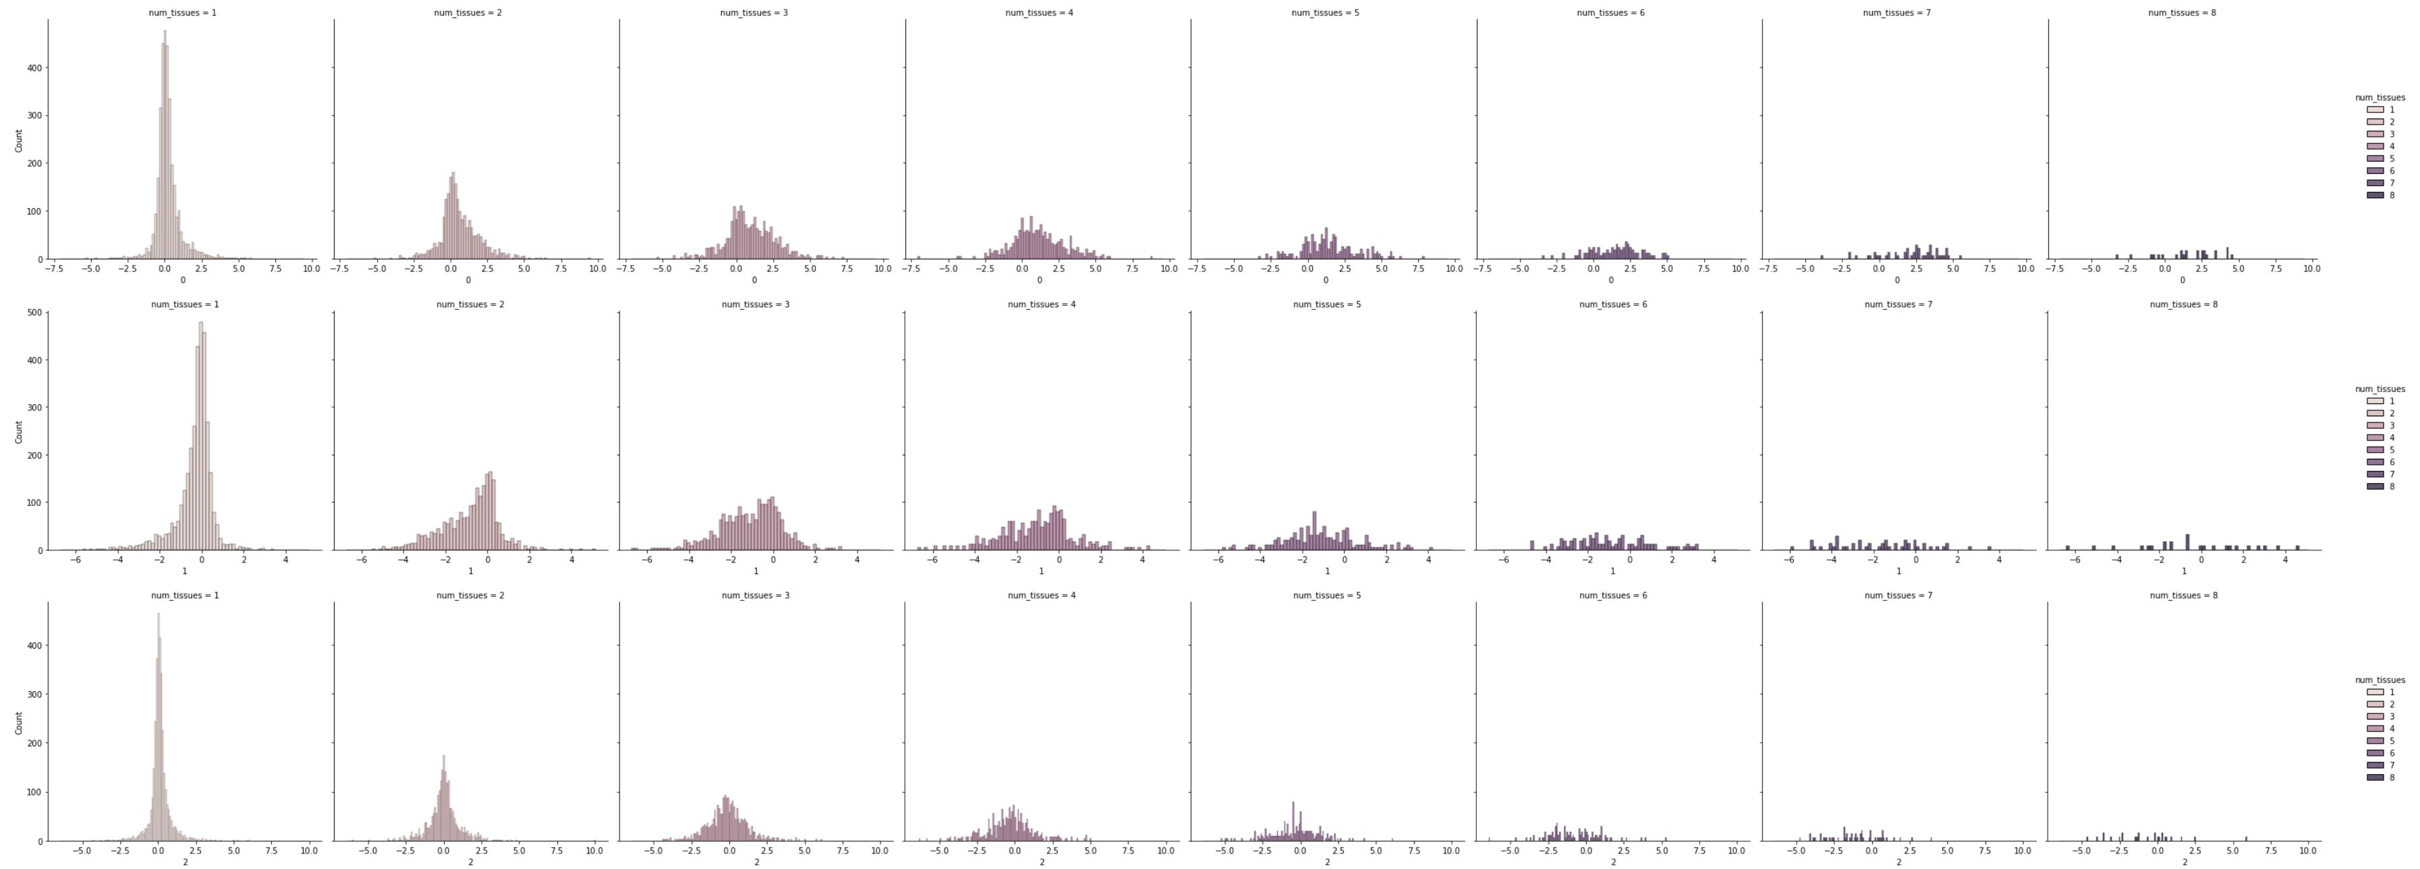
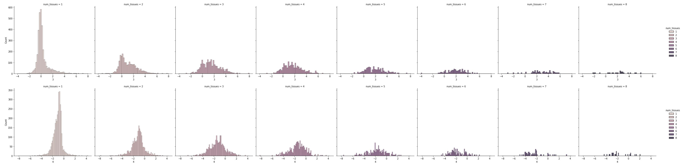
Embedding distribution by tissue span and cluster
0 = first embedding
1 = second embedding
etc…

